Slide 1
COMP-4150 ADVANCED AND PRACTICAL DB SYSTEMS
PART-B- PL/SQL-Triggers
Fall-2019

Slide 2
OUTLINE
SECTION-I - Introduction
PL/SQL Overview
Anonymous Blocks
Data Types
Variables
Comments & Constants
SECTION-II- Condition Control & LOOPS
IF statements
Case Statements
GO TO & NULL Statements
LOOPS (FOR, WHILE)
SECTION-III- Stored PROCEDURES and FUNCTIONS
Procedures
Functions
Cursor Variables
SECTION-III- CURSORS
PL/SQL Cursors
Cursor FOR LOOP
Cursor With Parameters

Slide 3
OUTLINE
SECTION-V-Packages
PL/SQL Packages
File Structure
SECTION-VI-Triggers
Statement Level
Row Level

Slide 4
SECTION-VI -TRIGGERS
PL/SQL Triggers
PL/SQL Statement-level Triggers
PL/SQL Row-level Triggers
PL/SQL Disable Triggers
PL/SQL Enable Triggers
PL/SQL Drop Triggers

Slide 5
What is an Oracle Trigger?
Named PL/SQL block stored in the Oracle Database and executed automatically when a triggering event takes place. The event can be any of the following:
A data manipulation language (DML) statement executed against a table e.g., INSERT, UPDATE, or DELETE. For example, if you define a trigger that fires before an INSERT statement on the customers table, the trigger will fire once before a new row is inserted into the customers table
A data definition language (DDL) statement executes e.g., CREATE or ALTER statement. These triggers are often used for auditing purposes to record changes of the schema.
A system event such as startup or shutdown of the Oracle Database
A user event such as login or logout
The act of executing a trigger is also known as firing a trigger

Slide 6
Using Oracle Triggers
Oracle triggers are useful in many cases such as the following:
Enforcing complex business rules that cannot be established using integrity constraint such as UNIQUE, NOT NULL, and CHECK
Preventing invalid transactions
Gathering statistical information on table accesses
Generating value automatically for derived columns
Auditing sensitive data

Slide 7
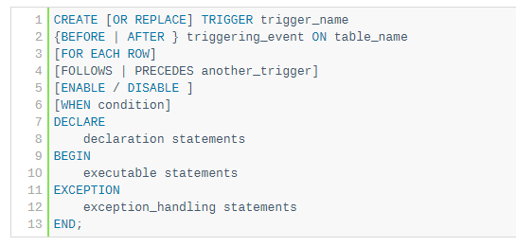
Creating a Trigger
CREATE TRIGGER statement:

Slide 8
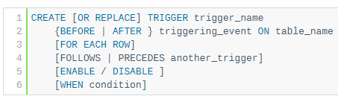

Parts of a Trigger- Header & Body
A trigger has two main parts: header and body
Header
Body

Slide 9
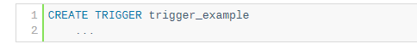
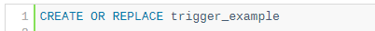
Parts of Trigger –Header
1) CREATE OR REPLACE
The CREATE keyword specifies that you are creating a new trigger. The OR REPLACE keywords are optional. They are used to modify an existing trigger.
For example, if today you define a new trigger named trigger_example:
And on the next day, you decide to modify this trigger. If you do not include the OR REPLACE keywords, you will receive an error message indicating that the name of your trigger is already used by another object:
Therefore, the CREATE OR REPLACE keywords will replace an existing trigger if it already exists and create a new trigger if the trigger does not:

Slide 10
Parts of Trigger –Header
2) Trigger name
Specify the name of the trigger that you want to create after the CREATE OR REPLACE keywords.
3) BEFORE | AFTER
The BEFORE or AFTER option specifies when the trigger fires, either before or after a triggering event e.g., INSERT, UPDATE, or DELETE

Slide 11
Parts of Trigger –Header
4) ON table_name
The table_name is the name of the table associated with the trigger.
5) FOR EACH ROW
The clause FOR EACH ROW specifies that the trigger is a row-level trigger. A row-level trigger fires once for each row inserted, updated, or deleted.
Besides the row-level triggers, we have statement-level triggers. A statement-trigger fire once regardless of the number of rows affected by the triggering event. If you omit the FOR EACH ROW clause, the CREATE TRIGGER statement will create a statement-level trigger.

Slide 12
Parts of Trigger –Header
6) ENABLE / DISABLE
The ENABLE / DISABLE option specifies whether the trigger is created in the enabled or disabled state. Note that if a trigger is disabled, it is not fired when the triggering event occurs.
By default, if you don’t specify the clause ENABLE / DISABLE , the trigger is created with the enabled state.
7) FOLLOWS | PRECEDES another_trigger
For each triggering event e.g., INSERT, UPDATE, or DELETE, you can define multiple triggers to fire. In this case, you need to specify the firing sequence using the FOLLOWS or PRECEDES option.

Slide 13
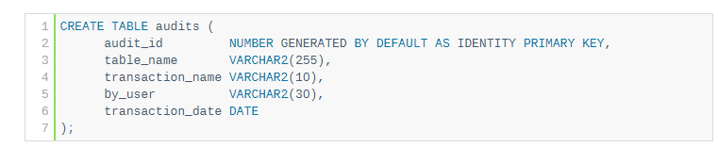
Creating a Trigger-Example
Suppose we want to record actions against the customers table whenever a customer is updated or deleted. In order to do this:
First, create a new table for recording the UPDATE and DELETE events:

Slide 14
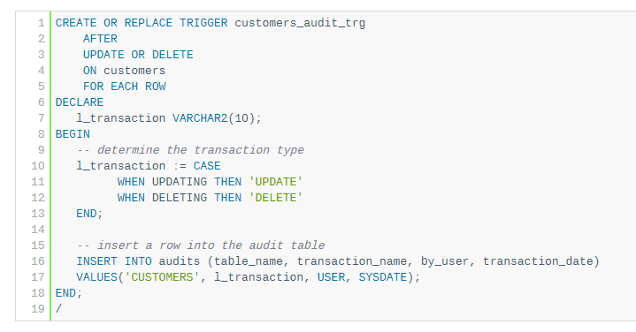
Creating a Trigger-Example
Second, create a new trigger associated with the customers table:

Slide 15
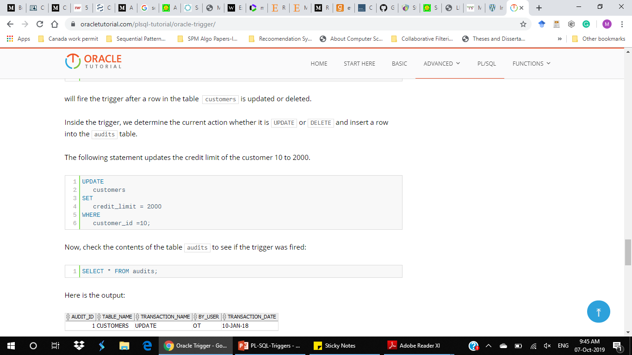
Testing the Trigger (With Update Action)
The following clause:
will fire the trigger after a row in the table customers is updated or deleted
Inside the trigger, we determine the current action whether it is UPDATE or DELETE and insert a row into the audits table
The following statement updates the credit limit of the customer 10 to 2000.
1 | AFTER UPDATE OR DELETE ON customers

Slide 16
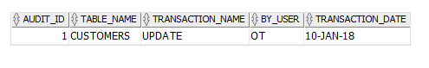
Now, check the contents of the table audits to see if the trigger was fired:
Here is the output:
As you can see clearly from the output, the trigger customers_audit_trg was fired so that we have a new row inserted into the audits table.
1 | SELECT * FROM audits;

Slide 17
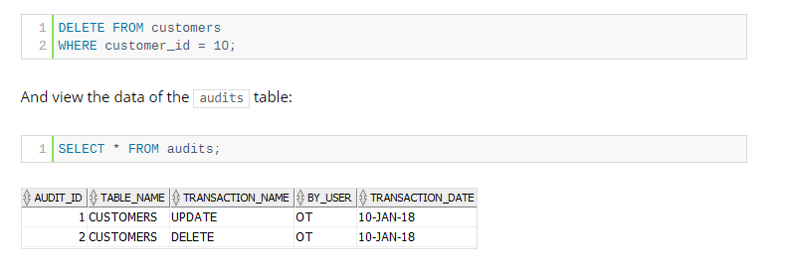
Testing the Trigger (With Delete Action)
This DELETE statement deletes a row from the customers table.
The output showed that a new row has been deleted. It means that the DELETE action fired the trigger customer_audit_trg.

Slide 18
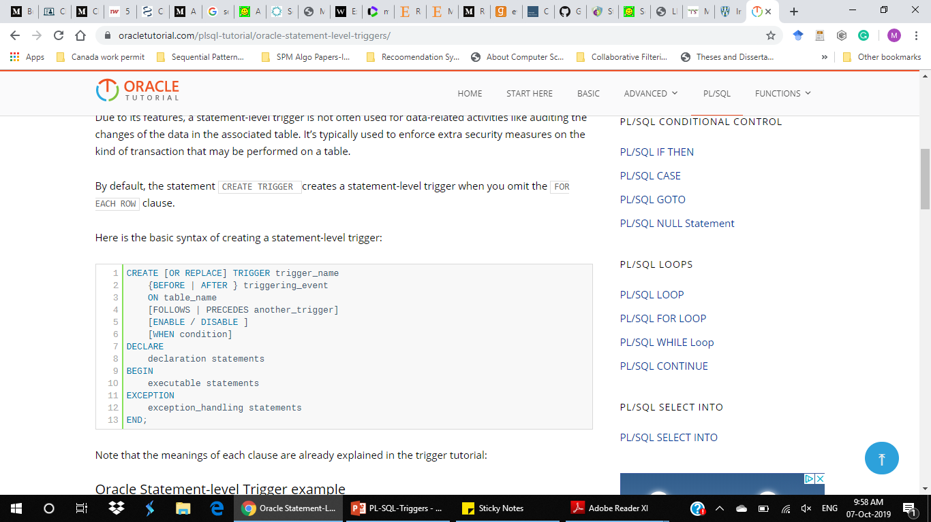
Statement Level Triggers
Fired whenever a trigger event occurs on a table regardless of how many rows are affected.
In other words, a statement-level trigger executes once for each transaction.
For example, if you update 1000 rows in a table, then a statement-level trigger on that table would only be executed once.
It’s typically used to enforce extra security measures on the kind of transaction that may be performed on a table.
By default, the statement CREATE TRIGGER creates a statement-level trigger when you omit the FOR EACH ROW clause.

Slide 19
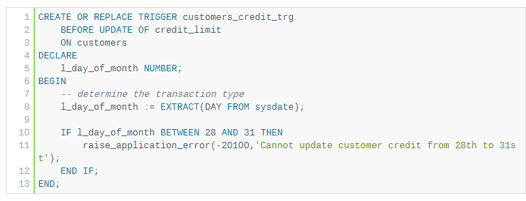
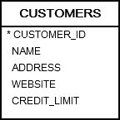
Statement Level Triggers-Example
We’ll use the table customers from the sample database for the demonstration:
Suppose, you want to restrict users to update credit of customers from 28th to 31st of every month so that you can close the financial month. To enforce this rule, you can use this statement-level trigger:

Slide 20
Statement Level Triggers-Example Explained
First, create a new trigger customers_credit_trg. The OR REPLACE modifies the trigger if it already exists:
Next, instruct the Oracle to fire the trigger only before update event for the credit_limit column of the customers table. If you update values in other columns rather than the credit_limit column, the trigger will not execute.
Then, declare a variable to hold the current day of the month:
1 | CREATE OR REPLACE TRIGGER customers_credit_trg
1 2 | BEFORE UPDATE OF credit_limit ON customers
1 2 | DECLARE l_day_of_month NUMBER;

Slide 21
Statement Level Triggers-Example Explained
After that, get the current day of the month using the EXTRACT() function:
Finally, check if the current day of the month is between 28th and 31st, use the procedure raise_application_error to raise a user-defined error:
1 | l_day_of_month := EXTRACT(DAY FROM sysdate);
1 2 3 | IF l_day_of_month BETWEEN 28 AND 31 THEN raise_application_error(-20100,'Cannot update customer credit from 28th to 31st'); END IF;

Slide 22
Testing the Statement Level Trigger
The following statement uses the UPDATE statement to increase the credit limit of all customer 10%:
Oracle issued the following error:
Note that Oracle automatically rollbacks the update because we call the raise_application_error procedure inside the trigger.
1 2 3 4 | UPDATE customers SET credit_limit = credit_limit * 110;
2 3 | ORA-20100: Cannot update customer credit from 28th to 31st ORA-06512: at "OT.CUSTOMERS_CREDIT_TRG", line 8 ORA-04088: error during execution of trigger 'OT.CUSTOMERS_CREDIT_TRG'

Slide 23
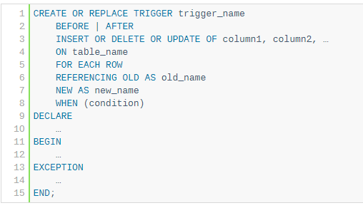
Row Level Triggers
Row-level triggers fires once for each row affected by the triggering event such as INSERT, UPDATE, or DELETE. Row-level triggers are useful for data-related activities such as data auditing and data validation.
To create a new row-level trigger, you use the CREATE TRIGGER statement with the FOR EACH ROW clause

Slide 24
The features which are applicable to the statement-level triggers are also available the row-level trigger:
Use raise_application_error() to raise a user-defined exception
Check if the current event is INSERT, UPDATE, and DELETE using the INSERTING or DELETING or UPDATING.
On top of that, row-level triggers allow you to track the BEFORE and AFTER values.
1 2 | :OLD.column_name :NEW.column_name

Slide 25
The :OLD & :NEW column values
Because row-level triggers execute within the context of a single row, you can access the old and new column values using the following syntax:
For example, this statement checks the value of the credit_limit column to see if the new credit is greater than the current credit:
1 2 | :OLD.column_name :NEW.column_name
1 2 3 | IF :NEW.credit_limit > :OLD.credit_limit THEN -- carry an action END;

Slide 26
This table illustrates the availability of :NEW and :OLD variables by the triggering event:
Triggering Event | :NEW | :OLD
INSERT | Yes | No
UPDATE | Yes | Yes
DELETE | No | yes

Slide 27
Performance Consideration
A row-level trigger fires each time a row is affected by a triggering event. For example, if you update 1000 rows in a table, the trigger will fire 1000 times, which potentially cause a performance issue.
To specify a condition of when to fire the trigger, you can use the WHEN clause. For example, the following trigger only fires when you update credit for a customer with the new credit is greater than 10,000:
1 2 3 4 5 6 | CREATE OR REPLACE TRIGGER BEFORE UPDATE OF credit_limit ON customers FOR EACH ROW WHEN NEW.credit_limit > 10000; ...

Slide 28
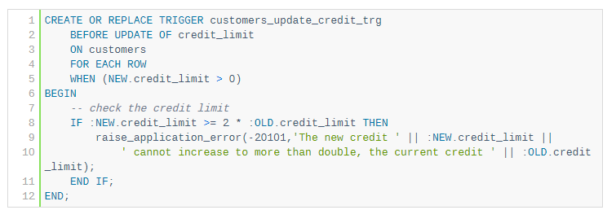
Row Level Trigger-Example
Customers table from the sample database for demonstration:
The following example creates a row-level trigger that prevents users from updating credit for a customer if the new credit increases to more than double:

Slide 29
Row Level Trigger-Example Explained
First, specify the name of the trigger:
Next, set the triggering event is BEFORE UPDATE of the credit_limit column on the customers table.
Then, use the FOR EACH ROW to specify that the trigger is a row-level trigger.
After that, specify the condition that fires trigger only when the new credit is greater than zero in the WHEN clause:
1 | CREATE OR REPLACE TRIGGER customers_update_credit_trg
1 2 | BEFORE UPDATE OF credit_limit ON customers
1 | FOR EACH ROW
1 | WHEN (NEW.credit_limit > 0)

Slide 30
Finally, check the new credit from the :NEW variable with the current credit from the :OLD variable, call the procedure raise_application_error to raise an error if it is.
1 2 3 4 | IF :NEW.credit_limit >= 2 * :OLD.credit_limit THEN raise_application_error(-20101,'The new credit ' || :NEW.credit_limit || ' cannot increase to more than double, the current credit ' || :OLD.credit_limit); END IF;

Slide 31
Row Level Trigger-Testing
First, find the credit limit of the customer id 10:
Here is the output:
Second, update the credit of the customer 10 to 5000:
1 2 3 | SELECT credit_limit FROM customers WHERE customer_id = 10;
1 2 3 | CREDIT_LIMIT ------------ 2000
1 2 3 | UPDATE customers SET credit_limit = 5000 WHERE customer_id = 10;

Slide 32
The output is as follows:
It means that the trigger customers_update_credit_trg has been fired as expected.
1 2 3 | ORA-20101: The new credit 5000 cannot increase more than double, the current credit 2000 ORA-06512: at "OT.CUSTOMERS_UPDATE_CREDIT_TRG", line 4 ORA-04088: error during execution of trigger 'OT.CUSTOMERS_UPDATE_CREDIT_TRG'

Slide 33
Disabling a Trigger
Sometimes, you may want to disable a trigger for testing and troubleshooting purposes. To disable a trigger, you use the ALTER TRIGGER DISABLE statement:
you specify the name of the trigger that you want to disable after the ALTER TRIGGER keywords.
For example, to disable the trigger customers_audit_trigger of the customers table, you use the following statement:
1 | ALTER TRIGGER trigger_name DISABLE;
1 | ALTER TRIGGER customers_audit_trg DISABLE;

Slide 34
Disabling All Triggers
To disable all triggers associated with a table, you use the ATLER TABLE ... DISABLE ALL TRIGGERS statement:
Specify the name of the table to which the triggers that you want to disable belong.
For example, to disable all triggers associated with the customers table, you use the following statement:
1 | ALTER TABLE table_name DISABLE ALL TRIGGERS;
1 | ALTER TABLE customers DISABLE ALL TRIGGERS;

Slide 35
Creating a Disabled Trigger-Example
Sometimes, you may want to create a disabled trigger which is a trigger in the disabled state.
For example, you want to create a trigger during the business hours and do not want to impact the current transactions.
To do it safely, you can create a trigger in the disabled state first. And then enable it later during the maintenance hours or at the weekend.
To create a trigger in the disabled state, you use the CREATE TRIGGER statement with the DISABLE option:

Slide 36
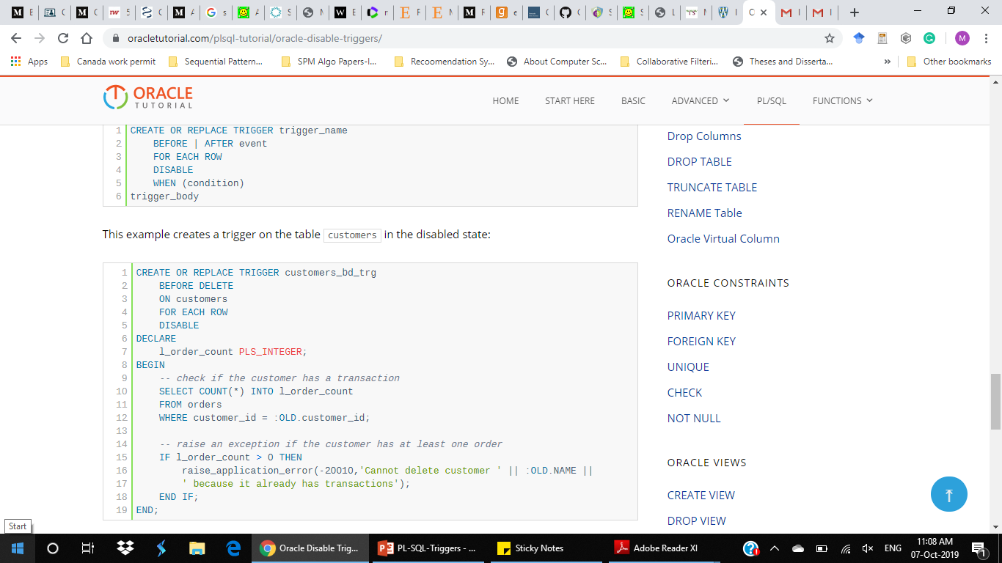
Example
Syntax

Slide 37
Enable a Trigger
To enable a previously disabled trigger, you use the ALTER TRIGGER ENABLE statement:
In this syntax, you place the name of the trigger that you want to enable after the ALTER TRIGGER keywords.
For example, the following statement enables the customers_audit_trg trigger:
1 | ALTER TRIGGER trigger_name ENABLE;
1 | ALTER TRIGGER customers_audit_trg ENABLE;

Slide 38
Enabling All Triggers
To enable all triggers of a table, you can use the ALTER TABLE ... ENABLE ALL TRIGGERS statement:
For example, this statement enables all triggers of the customers table:
1 2 | ALTER TABLE table_name ENABLE ALL TRIGGERS;
1 2 | ALTER TABLE customers ENABLE ALL TRIGGERS;

Slide 39
DROP Trigger
The DROP TRIGGER statement allows you to remove a trigger from the database.
Here is the basic syntax of the DROP TRIGGER statement:
The following statement drops the trigger customers_audit_trg of the customers table:
1 | DROP TRIGGER [schema_name.] trigger_name;
1 | DROP TRIGGER customers_audit_trg;

